Slide 1
MS Project
Lecturer: Ngo Huy Bien
Software Engineering Department
Faculty of Information Technology
VNUHCM - University of Science
Ho Chi Minh City, Vietnam
nhbien@fit.hcmus.edu.vn

Slide 2

Objectives

Slide 3

Contents

Slide 4

References

Slide 5
Terms
Task
Duration
Start
Finish
Predecessors
Successors
Resource
Work
Recurring Task
Schedule
Summary Task

Slide 6
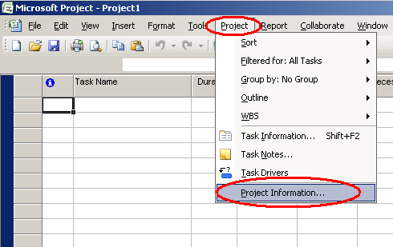
Edit Project Information (I)

Slide 7
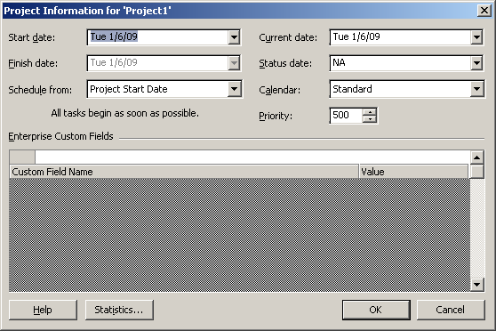
Edit Project Information (II)

Slide 8
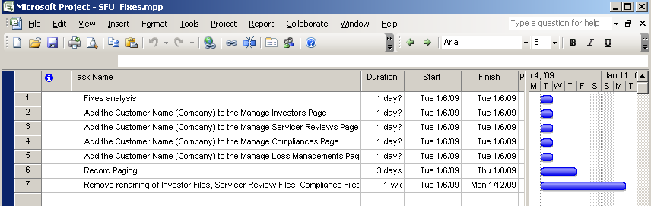
Enter a Task

Slide 9
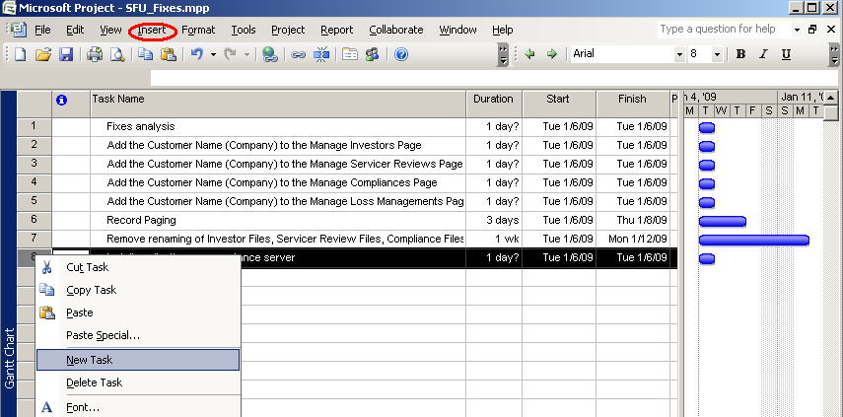
Insert a Task

Slide 10
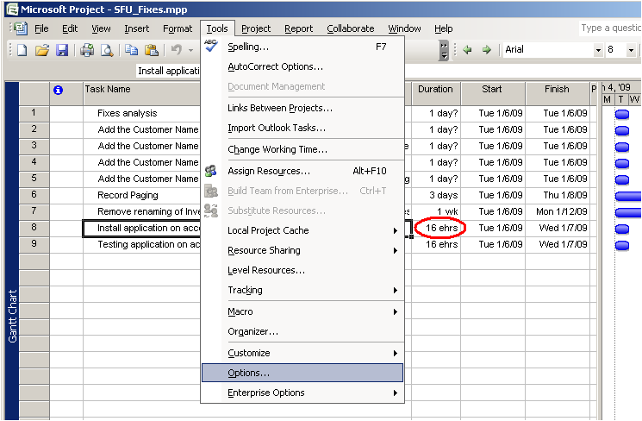
Eslaped Duration

Slide 11
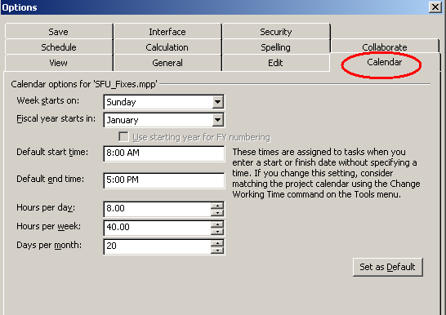
Calendar Option

Slide 12
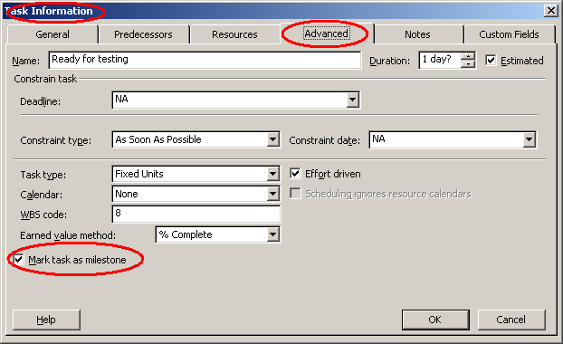
Milestone

Slide 13
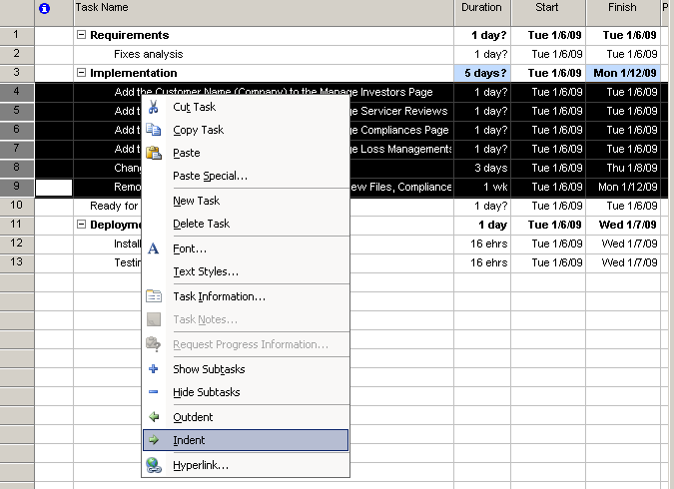
Summary Tasks

Slide 14
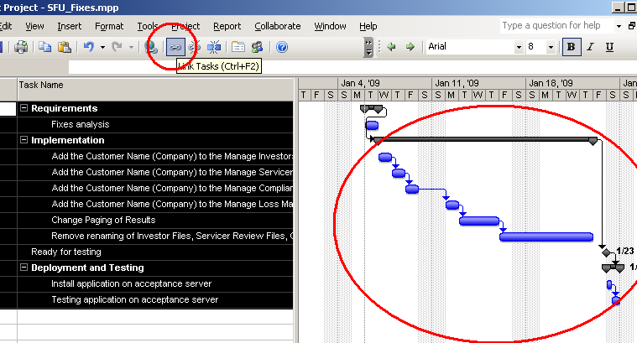
Link Tasks

Slide 15
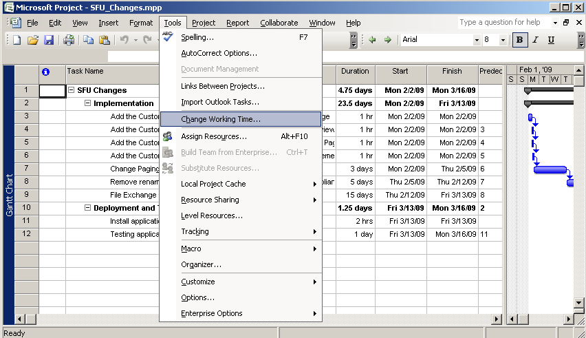
Working Time

Slide 16
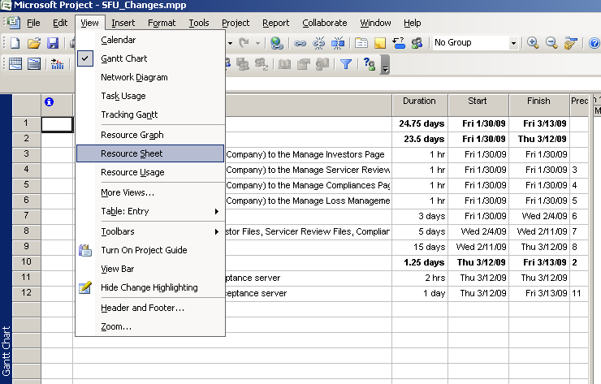
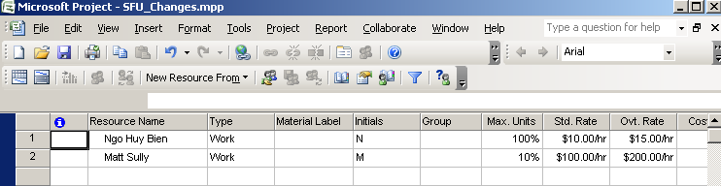
Setting Up People

Slide 17
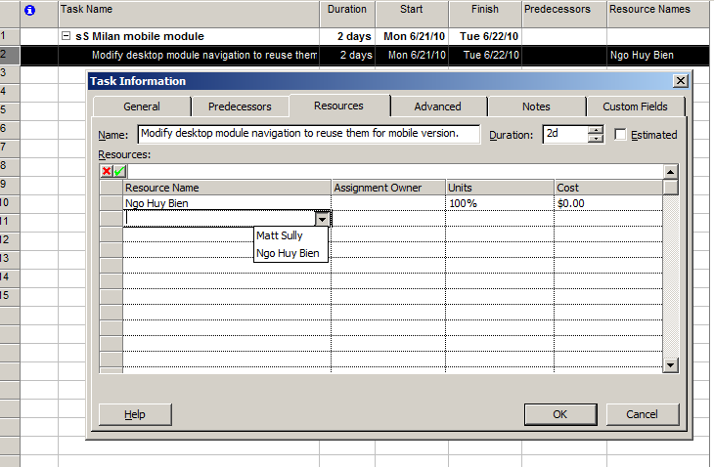
Assign Resource

Slide 18
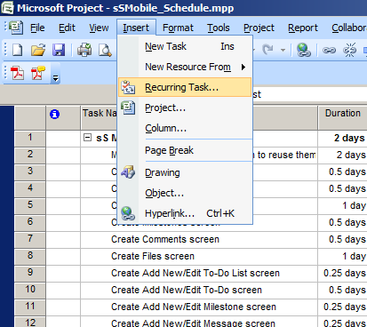
Recurring Task

Slide 19
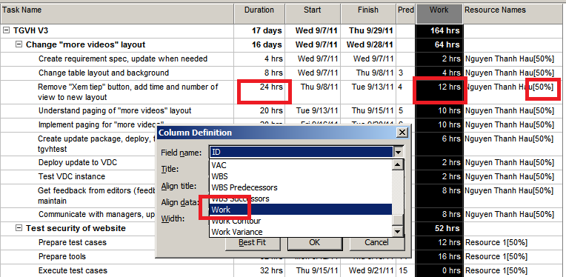
Work, Unit and Duration
Work = Duration X Units

Slide 20
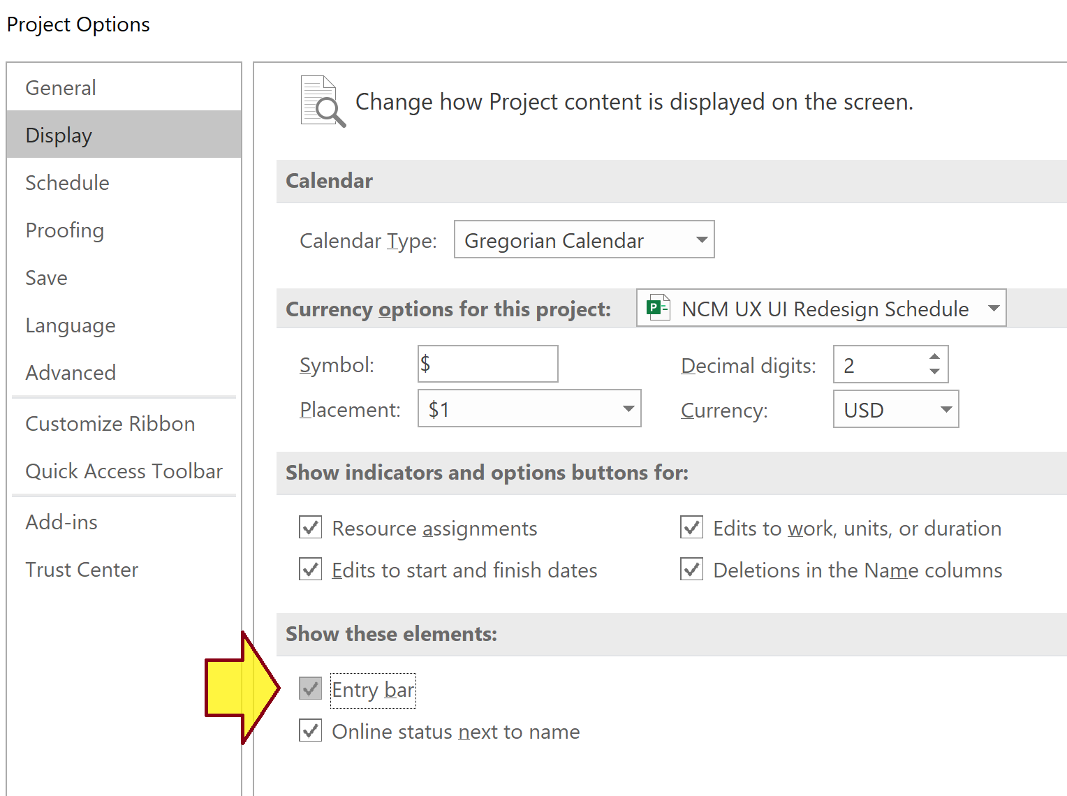
Enable Entry Bar
File > Options > Display > Entry bar

Slide 21
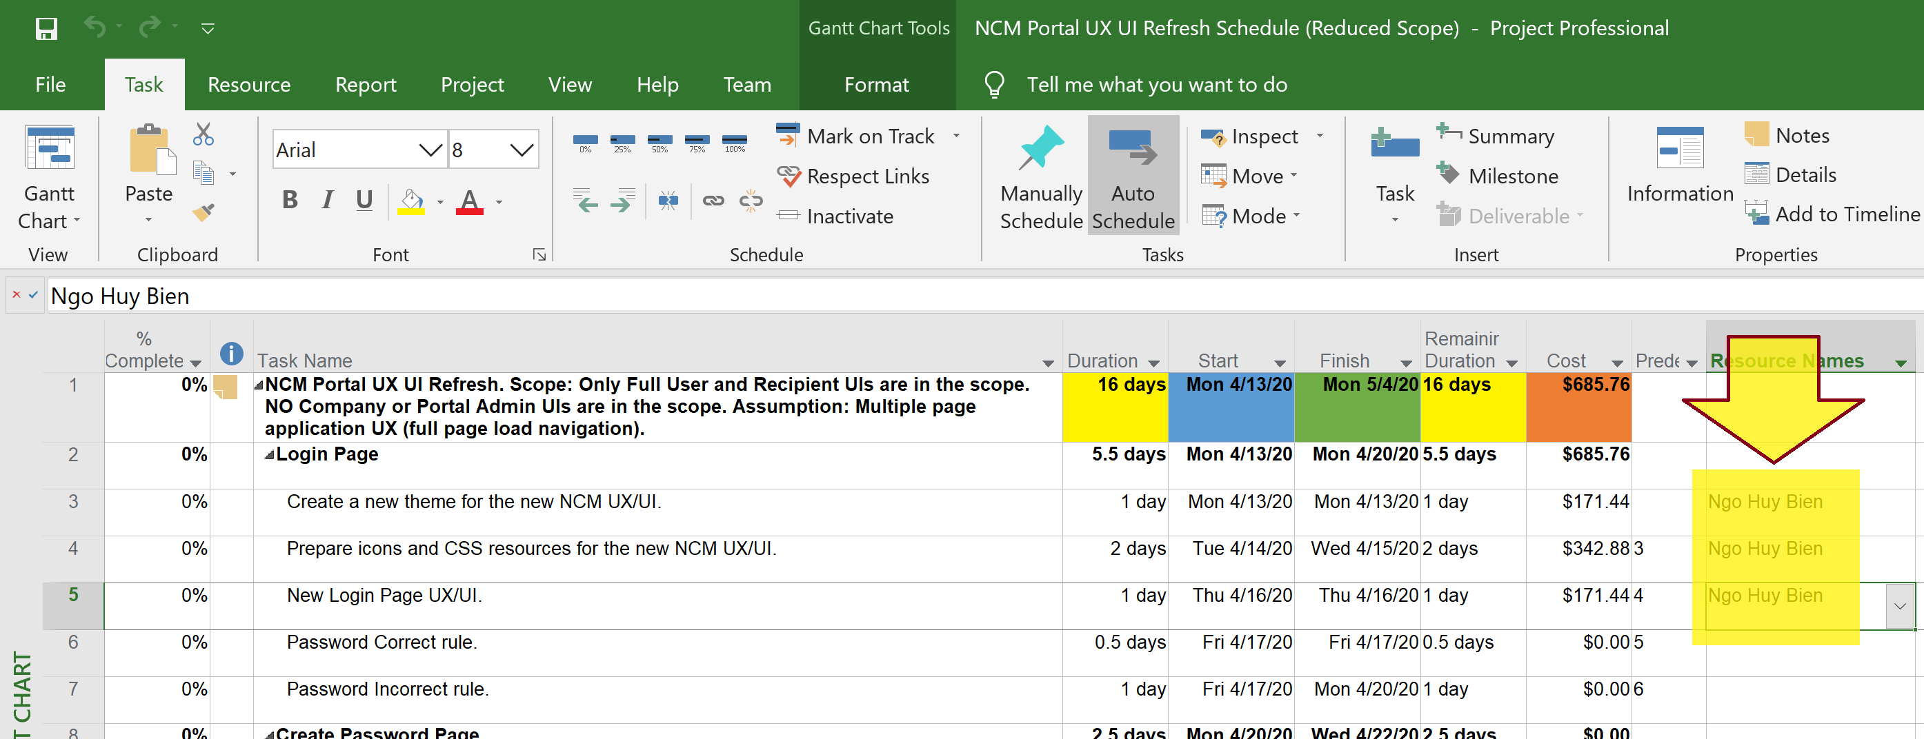
Auto Schedule – 1
Remove resources

Slide 22
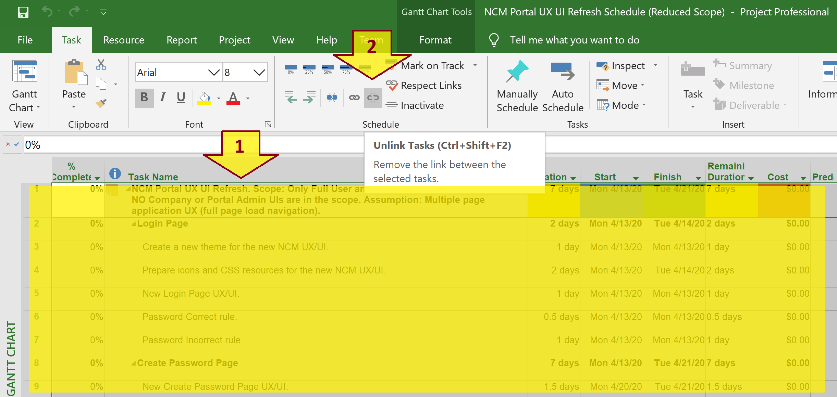
Auto Schedule – 2
Unlink all tasks

Slide 23
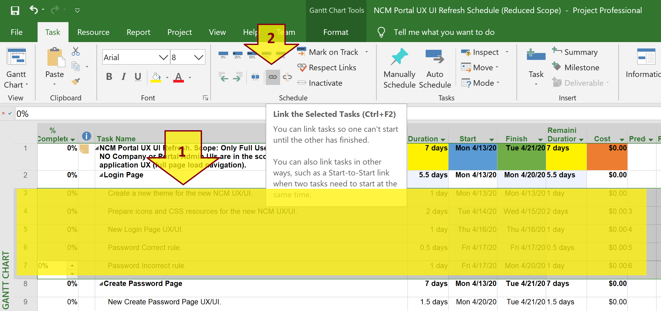
Auto Schedule – 3
Link the first group of tasks.

Slide 24
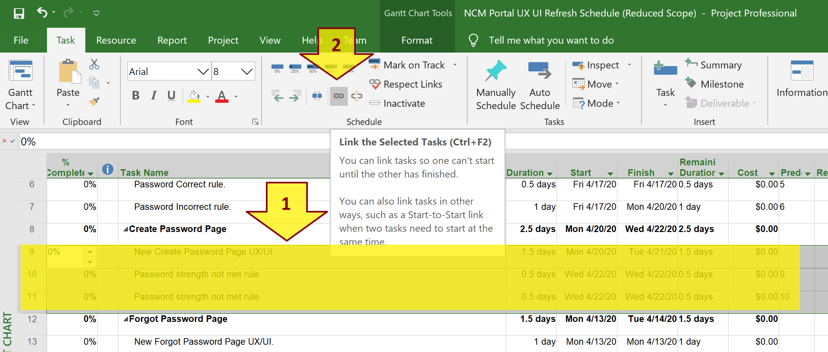
Auto Schedule – 4
Link the second group of tasks.

Slide 25
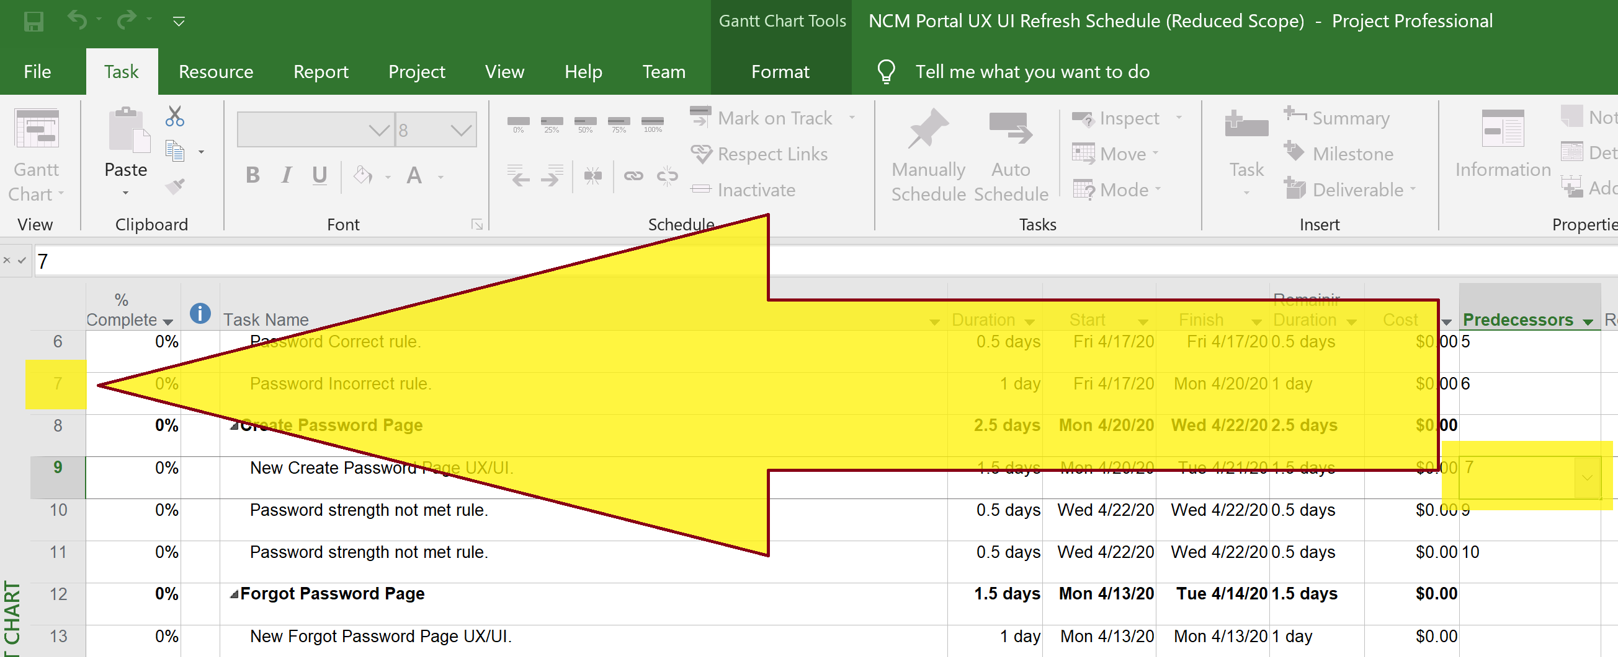
Auto Schedule – 5
Adjust the Predecessor of the first task of the second group of tasks.

Slide 26
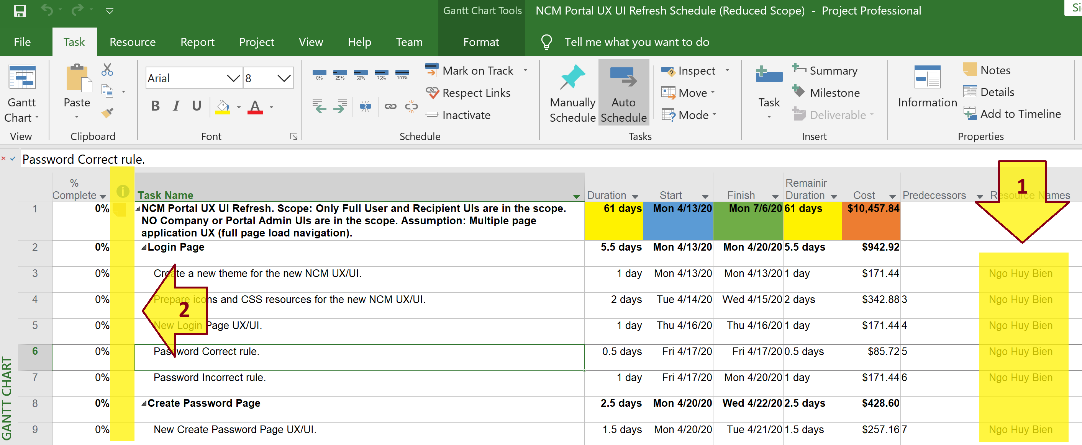
Auto Schedule – 6
Assign Resources to lowest level tasks.
Ensure that no conflicts appear.

Slide 27


Slide 28
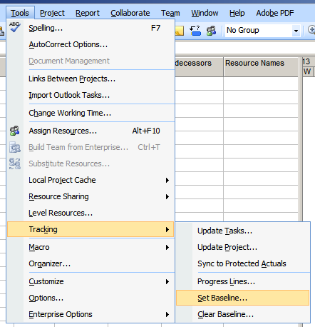
Baseline
When your boss asks how your project is doing compared to your original plan, the last thing you want to say is “I don’t know.”
You can avoid that fate by setting and saving a baseline as a snapshot of your original schedule before your project gets rolling.
The baseline is nothing else than a frozen picture of your project at a certain point time.

Slide 29
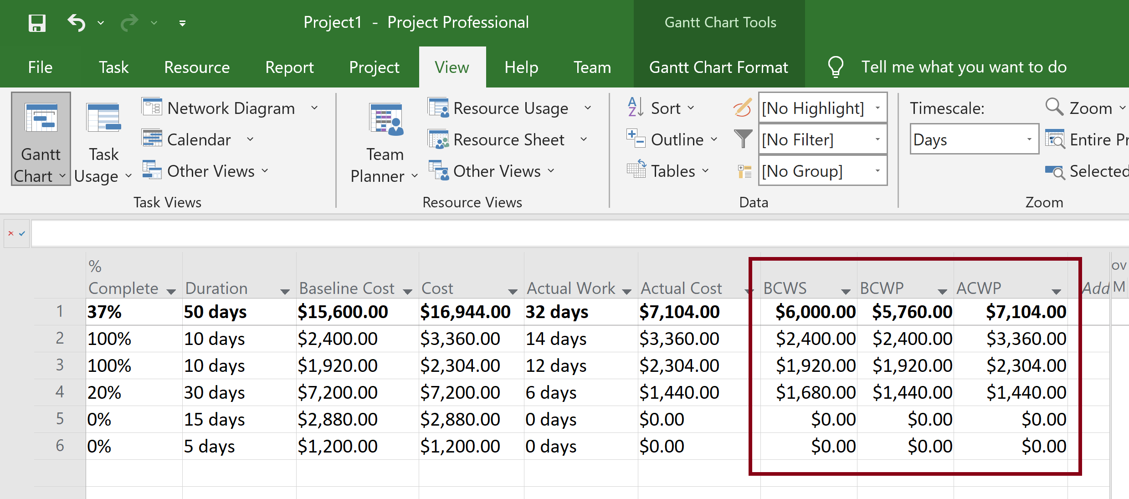
Enable Earned Value
Set Baseline (Create Baseline).
Set Status Date.

Slide 30
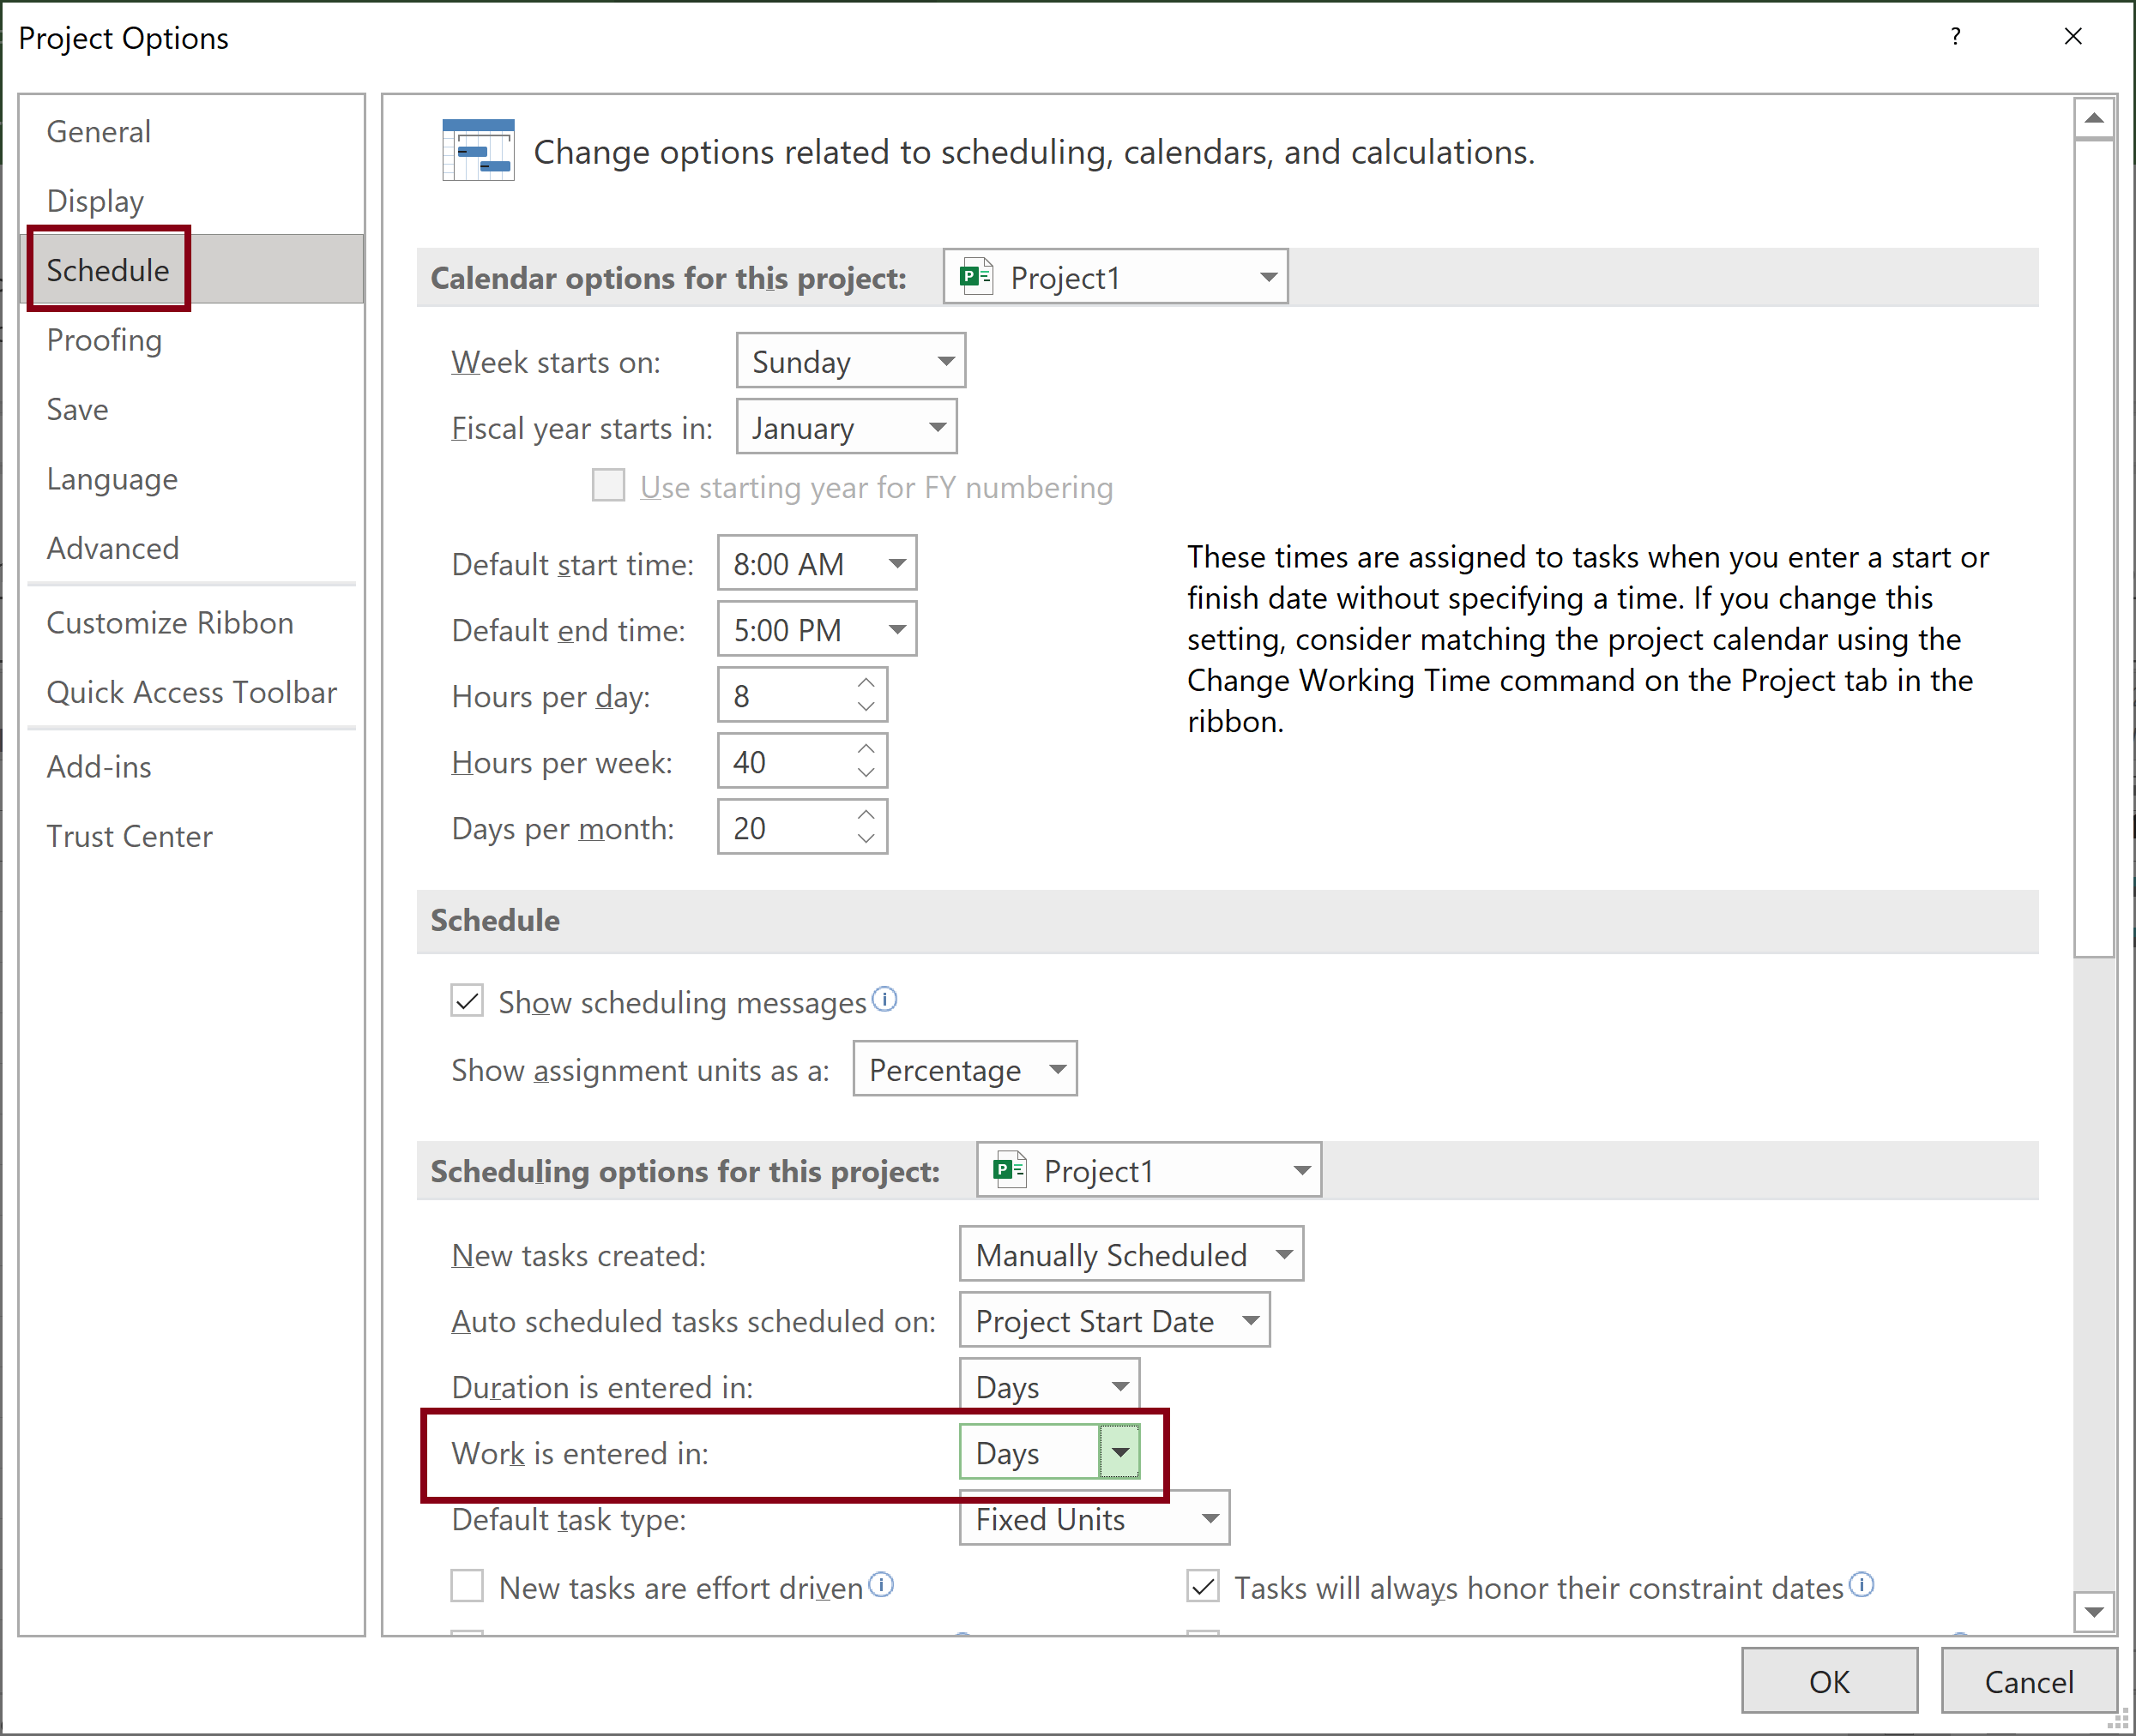
Show Work in Days
https://support.microsoft.com/en-us/office/change-the-default-time-unit-for-work-ce6dab74-d91e-4069-912a-8ca754bd9183
Choose File > Options.
In the Project Options dialog box, choose Schedule.
In the Work is entered in list, choose the time unit that you want.

Slide 31
Actual Work Fields
https://support.microsoft.com/en-us/office/actual-work-fields-24a92558-1d3f-4013-975e-7b2842fa0d2b
The Actual Work fields show the amount of work that has already been done by resources assigned to tasks.
When you first create a task, the Actual Work field contains "0 hrs" until you begin tracking the project by entering percent complete or actual work. As you enter percent complete, percent work complete, or actual work information, Microsoft Project updates actual work for the task.
If you enter a value in the Actual Work field for the task, Project divides the actual work you enter among the assigned resources.

Slide 32
Actual Cost Fields
https://support.microsoft.com/en-us/office/actual-cost-fields-b4edba82-9f2c-43a3-8e3a-43076b679fce
The Actual Cost fields show costs incurred for work already performed by resources on their tasks, along with any other recorded costs associated with the task.
Until actual work is reported on a task, the Actual Cost field contains 0.00.
You can choose to calculate all the actual costs as actual work is reported by each resource assigned to the task.
This is the cost of actual work plus any fixed costs for the task to date.

Slide 33
BCWS Fields
https://support.microsoft.com/en-us/office/bcws-fields-db87915c-6090-4650-a4d8-511996989a1d
The BCWS (budgeted cost of work scheduled) fields contain the cumulative timephased baseline costs up to the status date or today's date.
To calculate BCWS for a task, Microsoft Office Project adds the timephased baseline costs of the task up to the status date.

Slide 34
BCWP (Earned Value or EV) Fields
https://support.microsoft.com/en-us/office/bcwp-earned-value-or-ev-fields-e0c570ea-9c7b-4864-8a6b-920ed0f7b847
The BCWP (budgeted cost of work performed) fields contain the cumulative value of the task's, resource's, or assignments's percent complete multiplied by the timephased baseline costs. BCWP is calculated up to the status date or today's date.
When a task is first created, the BCWP is 0.00.
As soon as a baseline is saved and progress is reported for the task (as actual work, actual duration, or percentage of work complete), Microsoft Office Project calculates BCWP.
This calculation is based on the percentage of work complete, as compared with the task's baseline duration.
Project then calculates the cumulative baseline cost and provides the value of what the task's actual costs should be, given the task's progress to that point in the task's baseline duration.

Slide 35
ACWP Fields
https://support.microsoft.com/en-us/office/acwp-fields-710a1c21-b9f1-4516-9c78-986e87345277
The ACWP (actual cost of work performed) fields show costs incurred for work already done on a task, up to the project status date or today's date.
When a task is first created, the ACWP field contains 0.00.
As progress (percentage of completion or actual work) is reported on the task, Microsoft Office Project calculates the actual cost of work performed (ACWP).
This is the cost of actual work plus any fixed costs for the task to date.

Slide 36
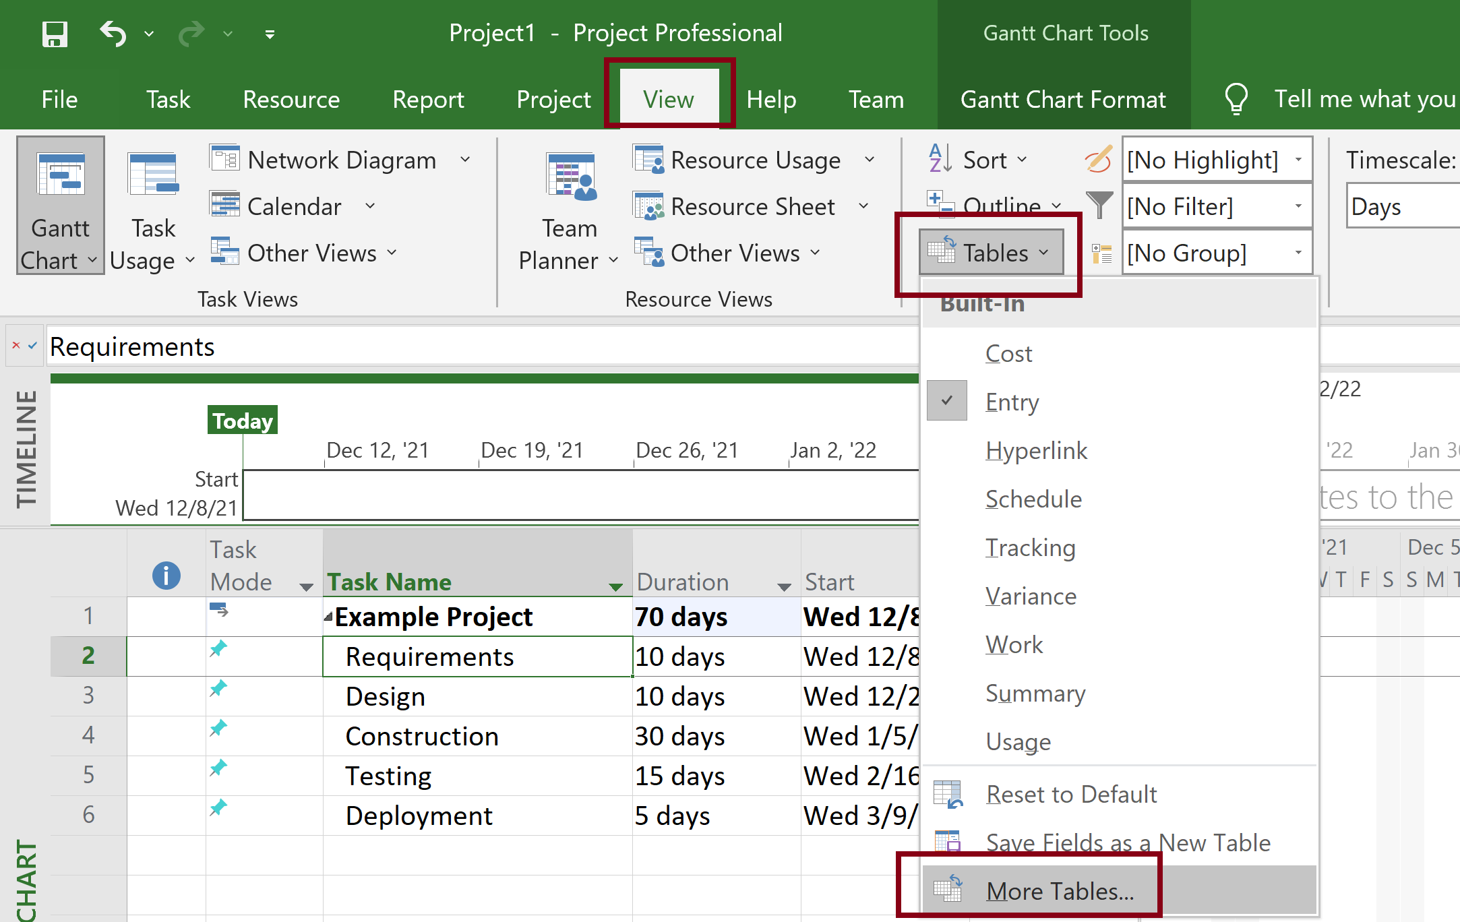
Open Earned Value Tables (I)

Slide 37
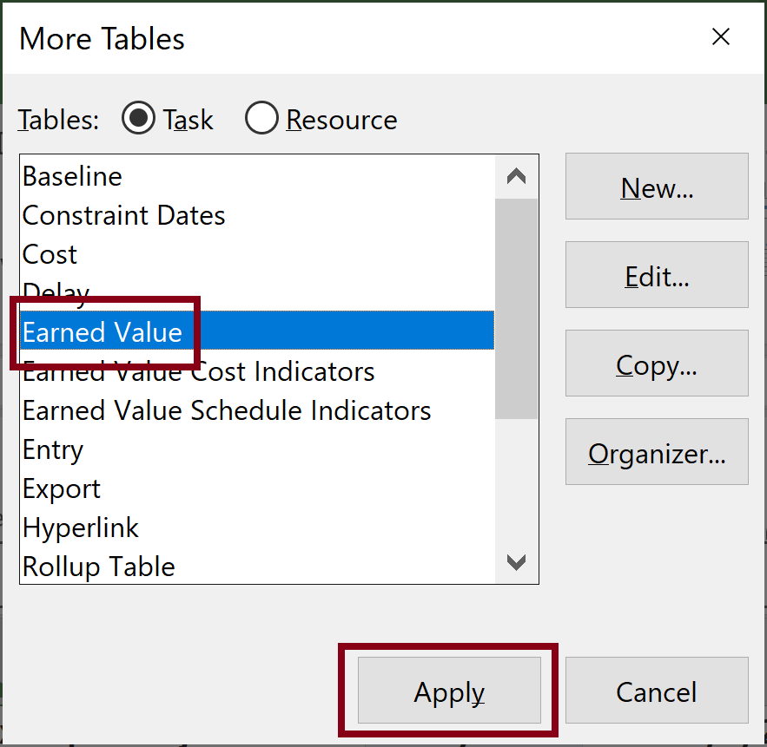
Open Earned Value Tables (II)

Slide 38
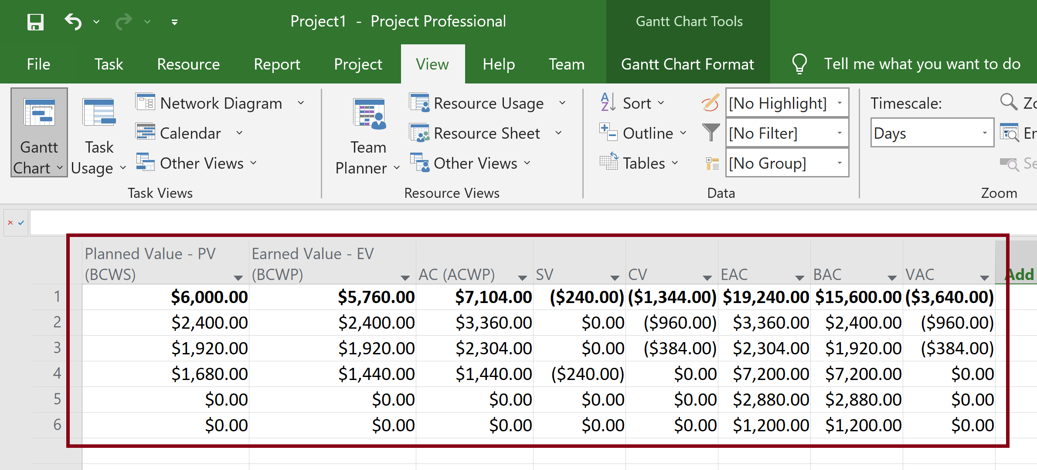
Open Earned Value Tables (III)

Slide 39
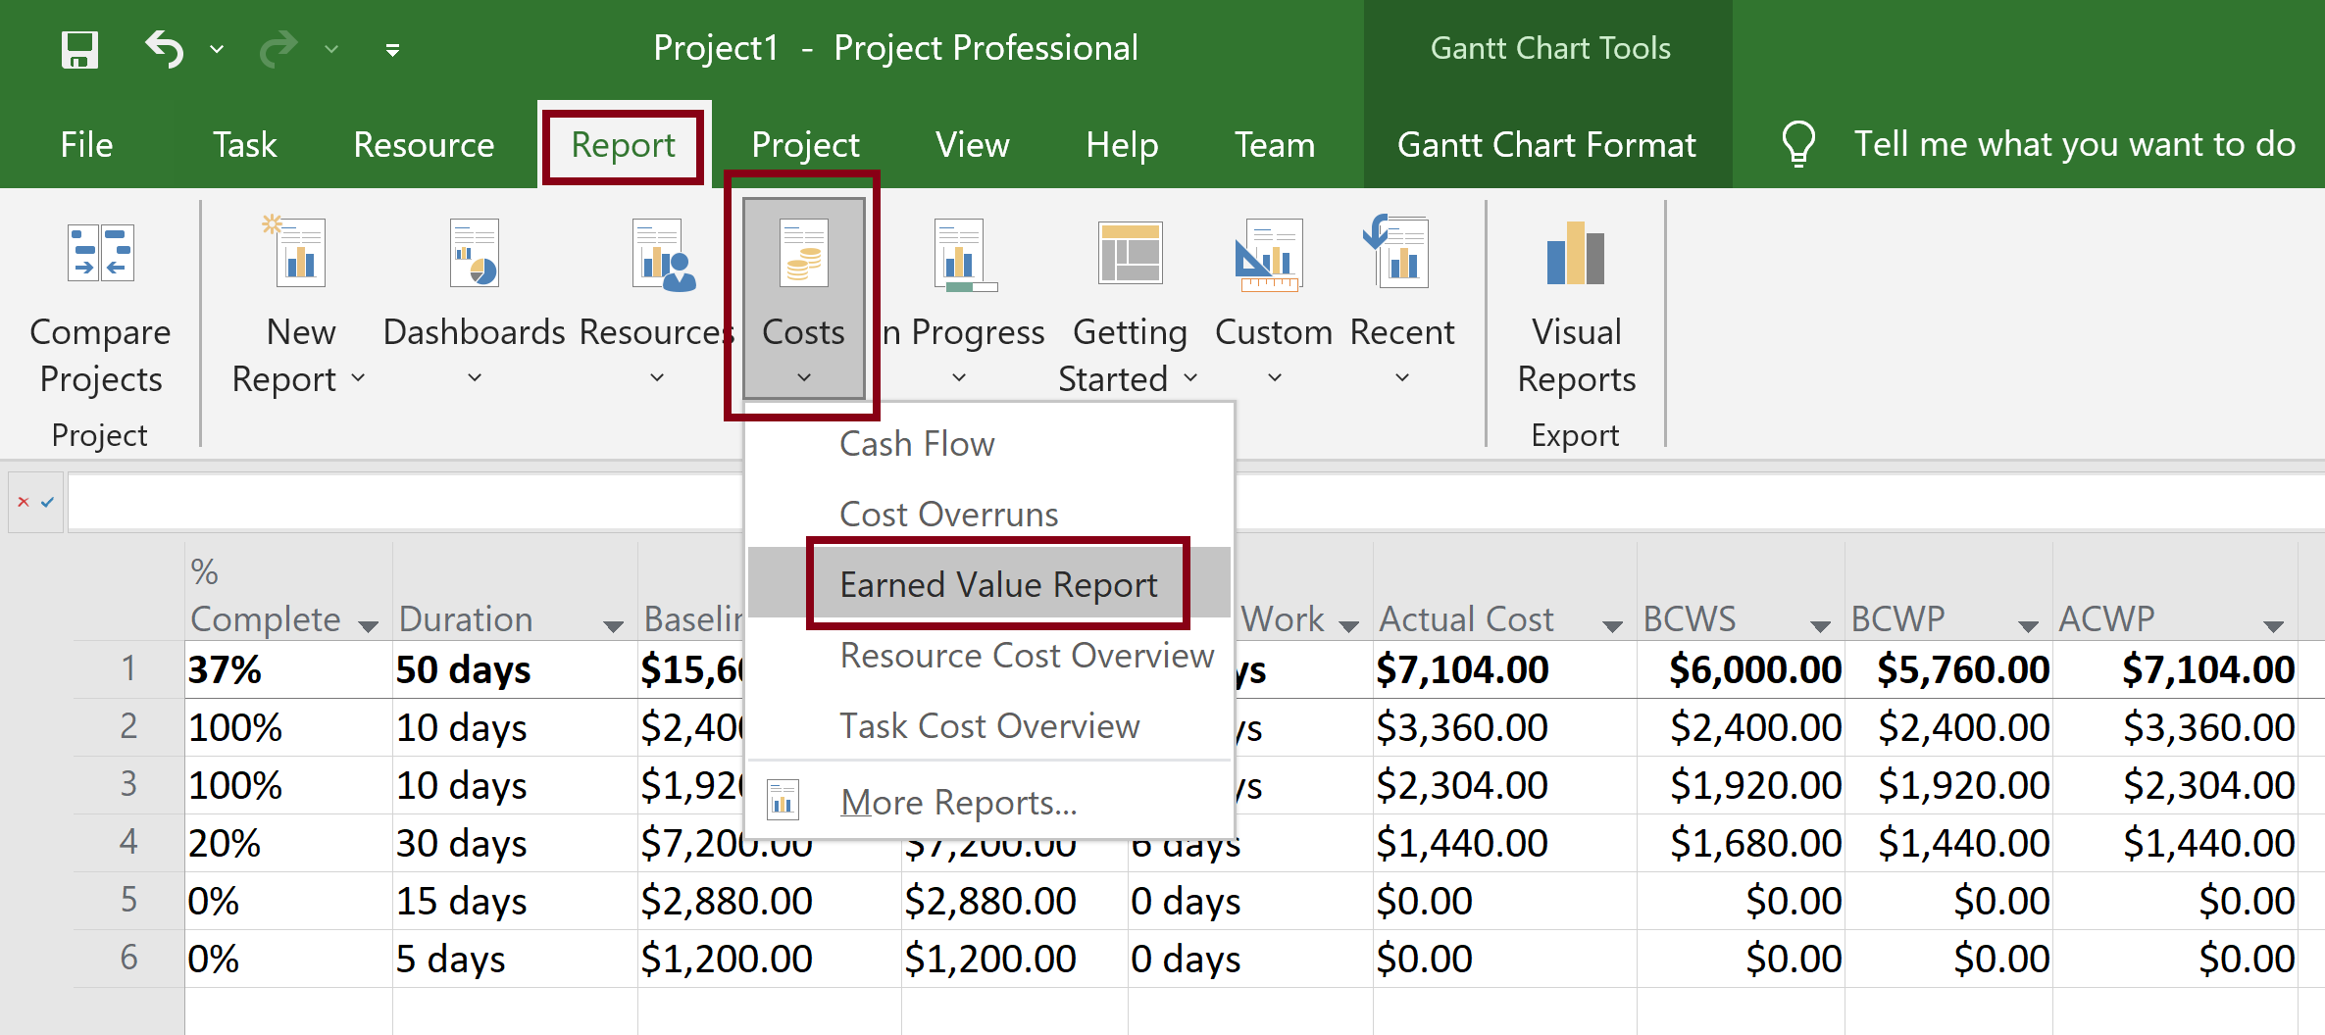
Show Earned Value Report (I)

Slide 40
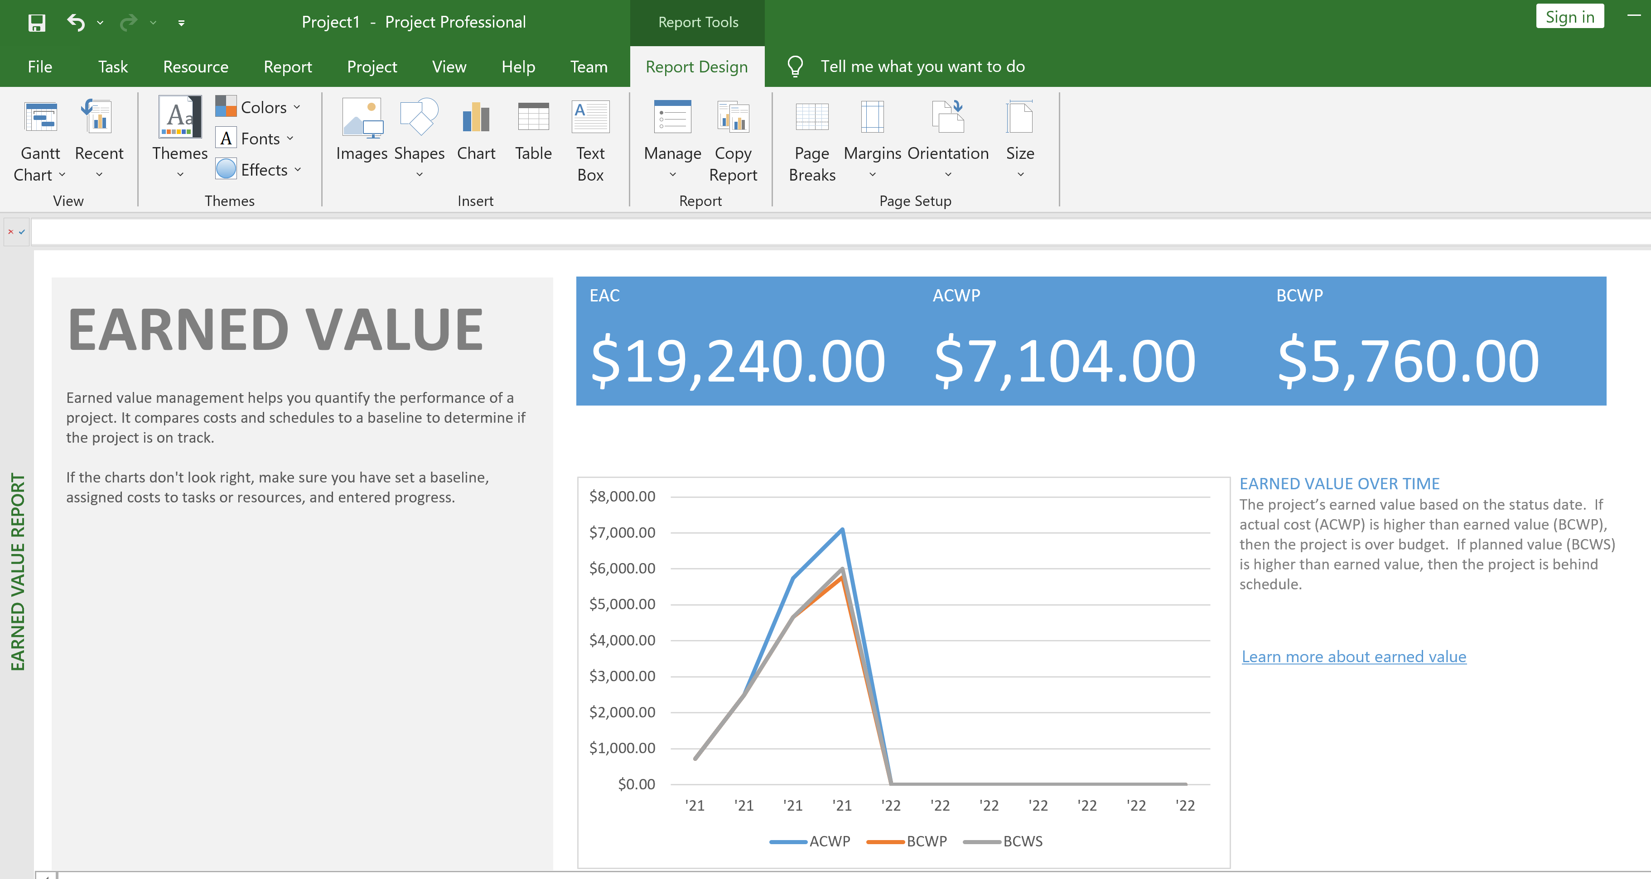
Show Earned Value Report (II)

Slide 41

Thank You & See You Again

